Slide 1
Diploma Thesis Defense
Cashless festival data analysis and analytical dashboard development
Author: Bc. Filip Ditrich
Supervisor: Mgr. Václav Alt, Ph.D.
Opponent: Ing. Hana Flusková

Slide 2
Outline
Introduction
Thesis Objectives
Methodology
Results
Conclusion
Questions from Reviews

Slide 3
Introduction
Context
Challenge and Problems
Background and Motivation

Slide 4
Introduction
Context
Traditional cash payments
Hard to manage and control
No data insights, unreliable reporting
Shift to cashless solutions in the last decade
NFCtron – a full-scope cashless payment solution for events and festivals:
Online ticket sales & top-ups
On-site payments & access control
Real-time analytics & reporting
Challenge and Problems
Background and Motivation

Slide 5
Introduction
Context
P1: NFCtron Hub Analytics include some basic metrics and more unstructured data
unused potential of the data
P2: The organizers are not data scientists
require simple and easy way to present
P3: There is a lot of data that’s not being used
find its analytical value, improve the system
Challenge and Problems
Background and Motivation

Slide 6
Introduction
Context
Chief Product Officer at NFCtron
Responsible for product development
Deep system knowledge, access to the data
Vision
Enhance NFCtron Hub analytics
Provide insights that the organizers want
Enable data-driven decisions
⇒ transform data into valuable insights for organizers
Challenge and Problems
Background and Motivation

Slide 7
Thesis Objectives
Research Questions
Requirements
Thesis Objectives

Slide 8
Thesis Objectives
Research Questions
Cooperation with a business client (organizer) at an undisclosed 3-day festival in 2024
Research questions defined based on the organizer needs
Total of 29 research questions in 4 key areas:
Cashflow and Revenue Sources
Performance Indicators
Beverage Consumption
Customer Analysis
Requirements
Thesis Objectives

Slide 9
Thesis Objectives
Research Questions
Data privacy
Anonymize sensitive data
Protect vendor information
Secure customer details
Client (organizer) needs
Keep event details undisclosed
Provide clear visualizations
Requirements
Thesis Objectives

Slide 10
Thesis Objectives
Research Questions
Data Analysis
Prepare, process and analyze available data from the festival
Find answers to all 29 research questions
Present clear results to the research questions
Dashboard Prototype
Implement a simple internal dashboard prototype to demonstrate the findings
Focus on key metrics and real data visualization
Requirements
Thesis Objectives

Slide 11
Methodology
Data Collection
Data Preperation
Data Enhancement
Data Anonymization
Tools and Technologies

Slide 12
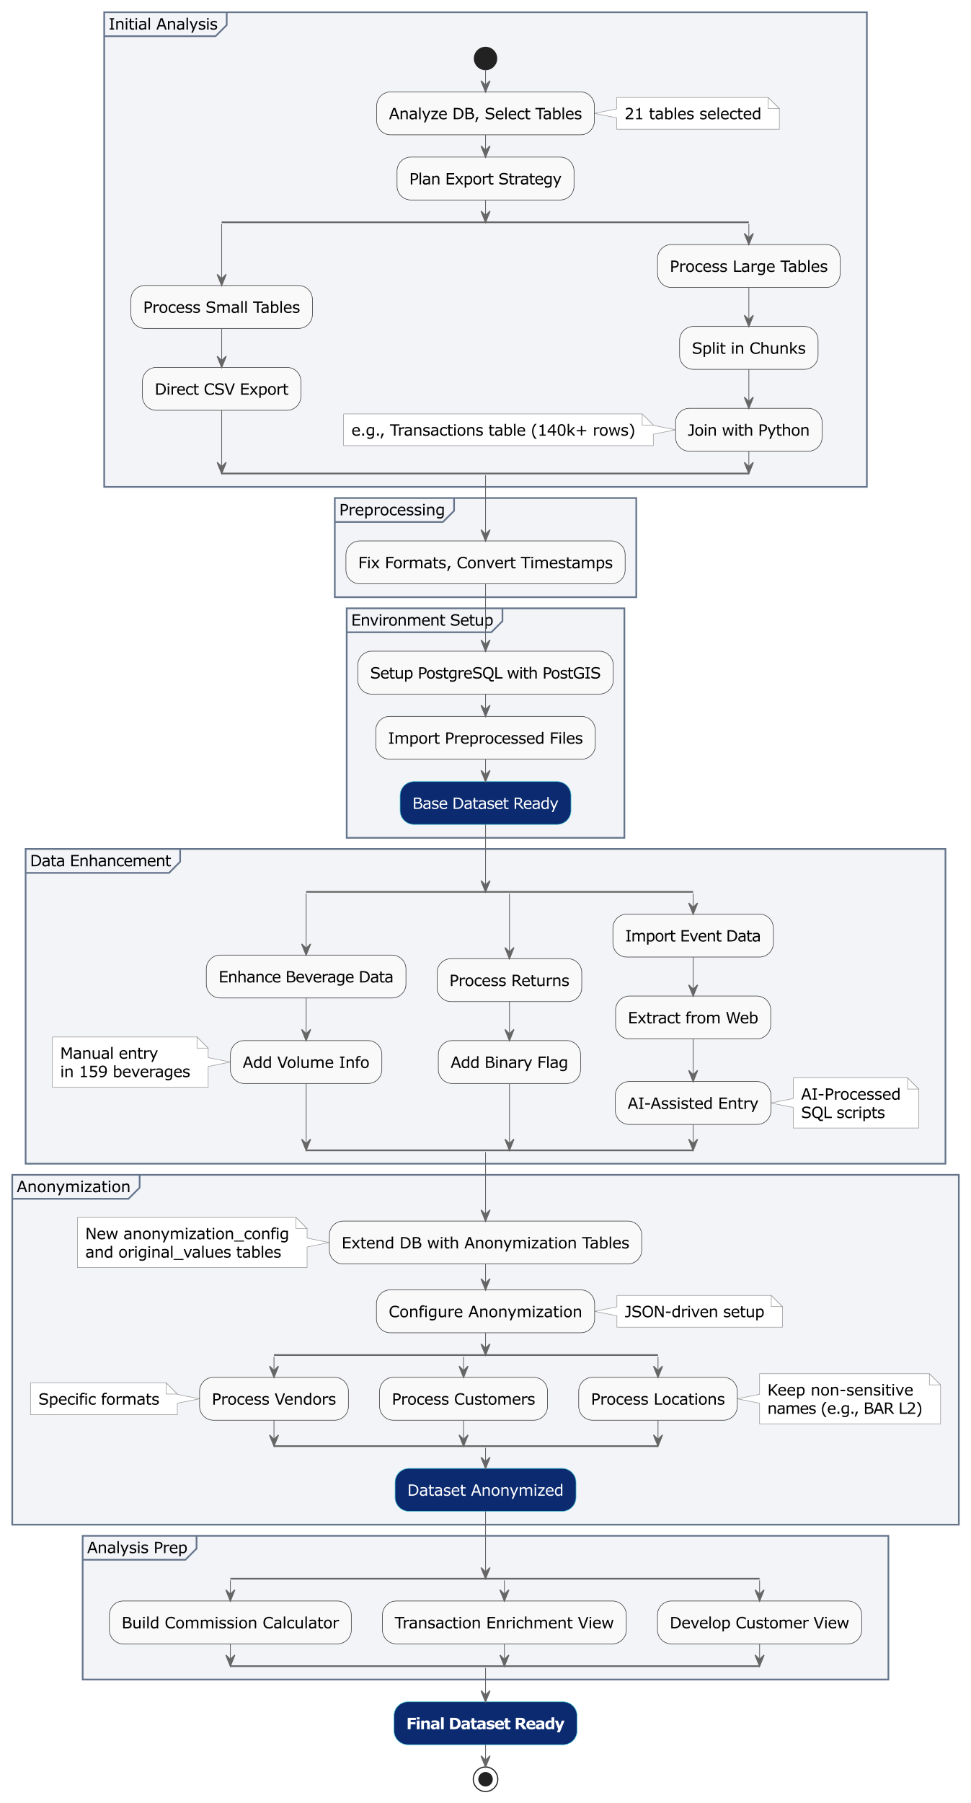
Methodology
Data Collection
Data Preperation
Data Enhancement
Data Anonymization
Tools and Technologies

Slide 13
Methodology
Data Collection
Data Preperation
Data Enhancement
Data Anonymization
Tools and Technologies

Slide 14
Methodology
Data Collection
Data Preperation
Data Enhancement
Data Anonymization
Tools and Technologies

Slide 15
Methodology
Data Collection
Data Preperation
Data Enhancement
Data Anonymization
Tools and Technologies

Slide 16




Methodology
Data Collection
PostgreSQL Database
Python
DataSpell IDE
Claude AI
Data Preperation
Data Enhancement
Data Anonymization
Tools and Technologies

Slide 17


Results
Data Analysis Results
29 Research Questions answered
– Cashflow and Revenue Sources
– Performance Indicators
– Beverage Consumption
– Customers
Dashboard Prototype
Using Python, Dash and Plotly

Slide 18

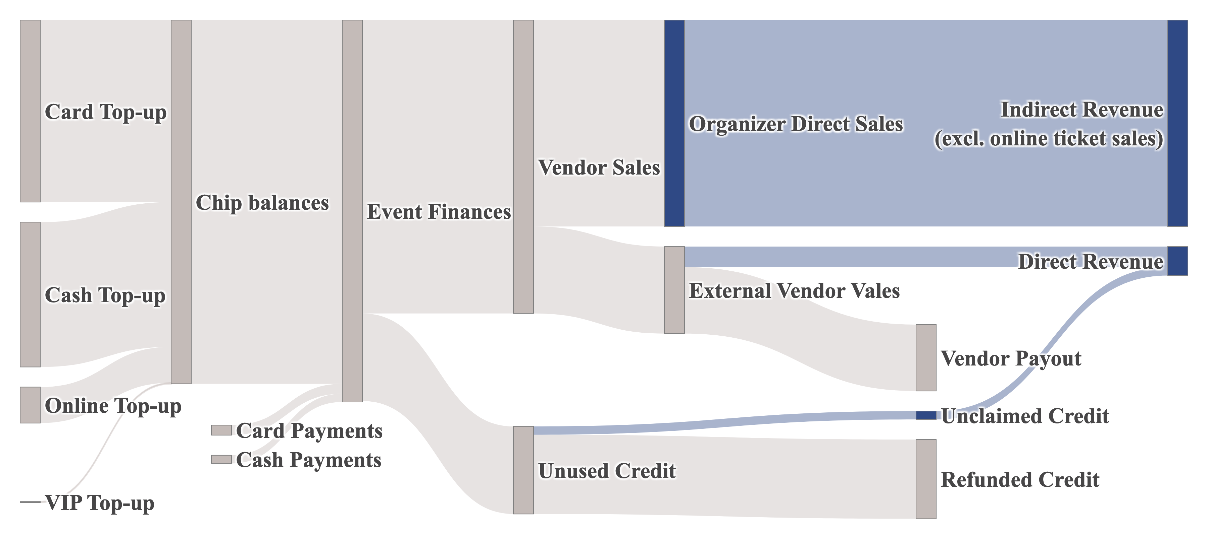
Results
Data Analysis Results
29 Research Questions answered
Overall Cash Flow Diagram
– Cashflow and Revenue Sources
– Performance Indicators
– Beverage Consumption
– Customers
Dashboard Prototype
Using Python, Dash and Plotly

Slide 19
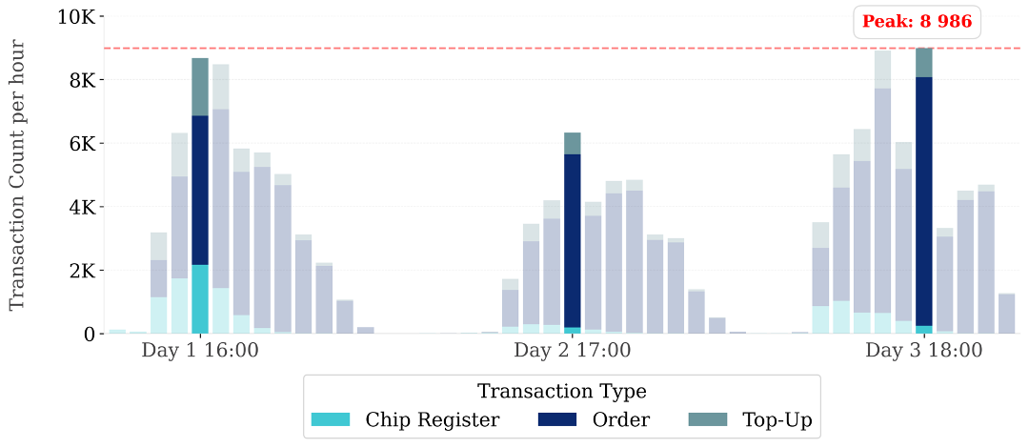
Results
Data Analysis Results
29 Research Questions answered
Transaction Processing Peaks
– Cashflow and Revenue Sources
– Performance Indicators
– Beverage Consumption
– Customers
Dashboard Prototype
Using Python, Dash and Plotly

Slide 20
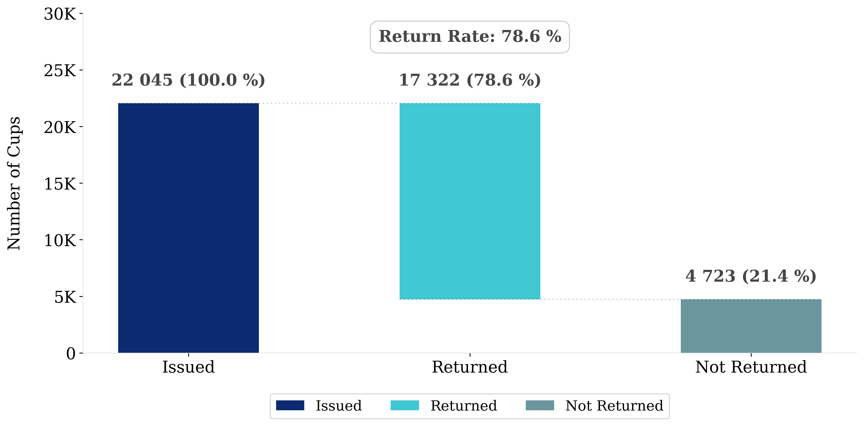
Results
Data Analysis Results
29 Research Questions answered
Returnable Cups Distribution
– Cashflow and Revenue Sources
– Performance Indicators
– Beverage Consumption
– Customers
Dashboard Prototype
Using Python, Dash and Plotly

Slide 21
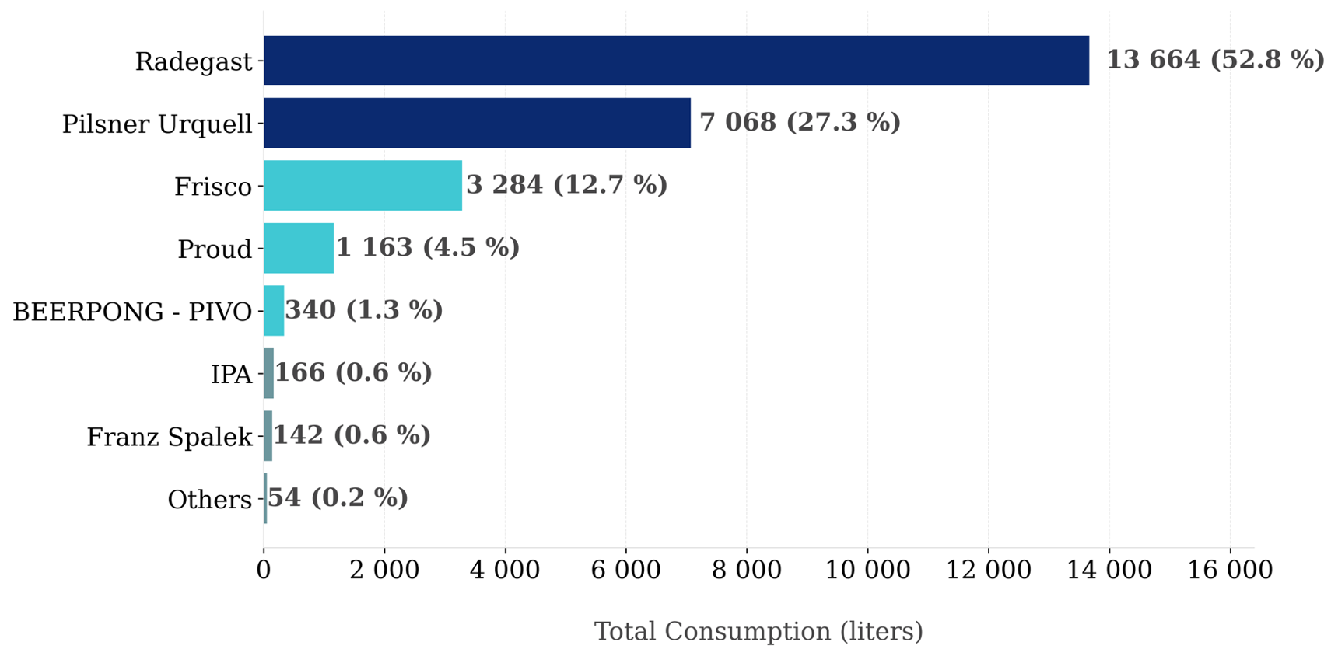
Results
Data Analysis Results
29 Research Questions answered
Most Consumer Beer Brands
– Cashflow and Revenue Sources
– Performance Indicators
– Beverage Consumption
– Customers
Dashboard Prototype
Using Python, Dash and Plotly

Slide 22
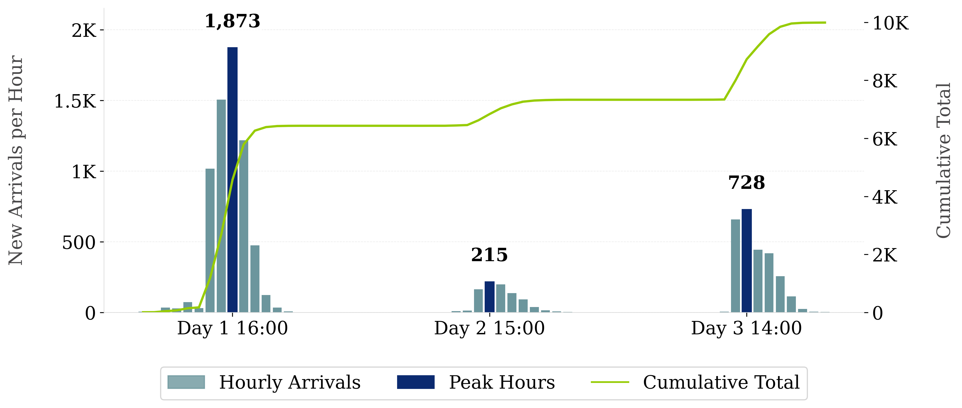
Results
Data Analysis Results
29 Research Questions answered
Visitor Arrival Patterns
– Cashflow and Revenue Sources
– Performance Indicators
– Beverage Consumption
– Customers
Dashboard Prototype
Using Python, Dash and Plotly
Day 1 (Thursday): 6 214 active customers
Day 2 (Friday): 5 832 active customers
Day 3 (Saturday): 8 066 active customers
Total: 10 009 unique customers

Slide 23
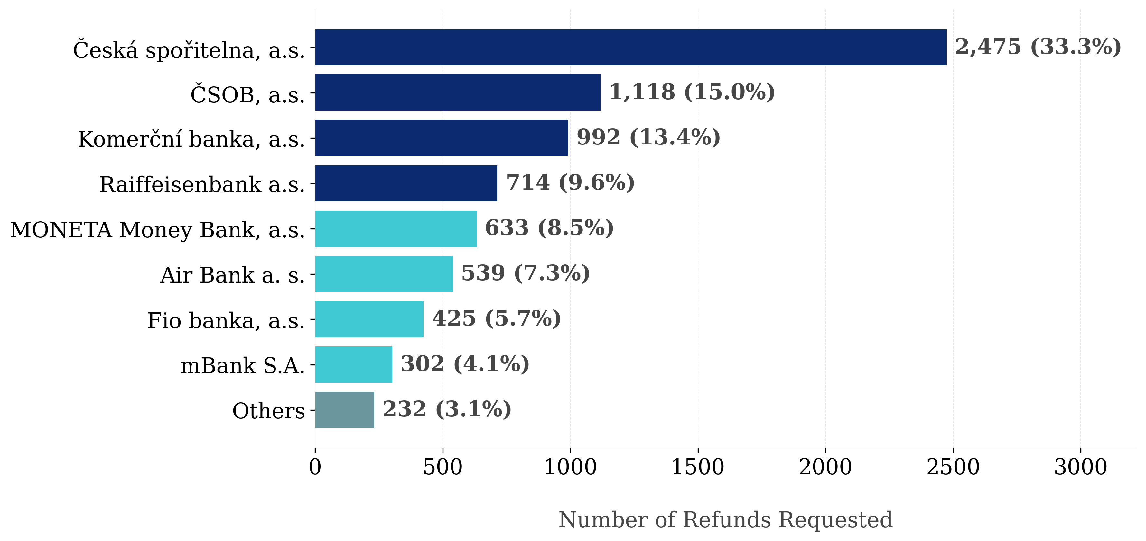
Results
Data Analysis Results
29 Research Questions answered
Distribution of Target Banks Used to Refund Credit
– Cashflow and Revenue Sources
– Performance Indicators
– Beverage Consumption
– Customers
Dashboard Prototype
Using Python, Dash and Plotly

Slide 24

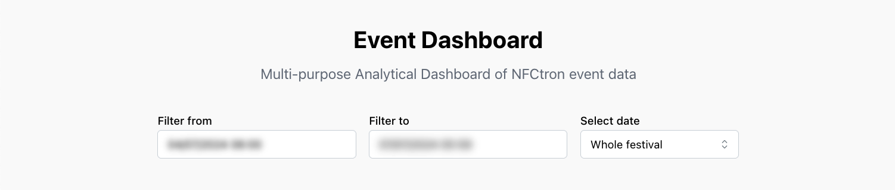
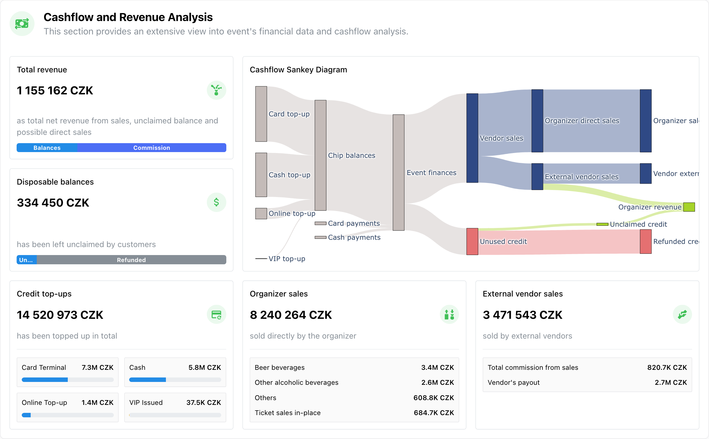

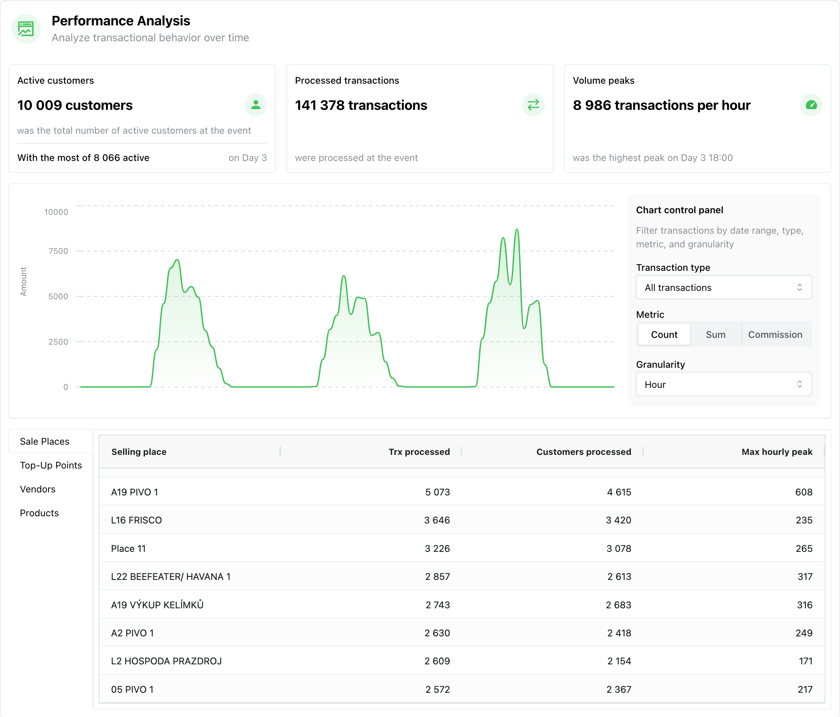
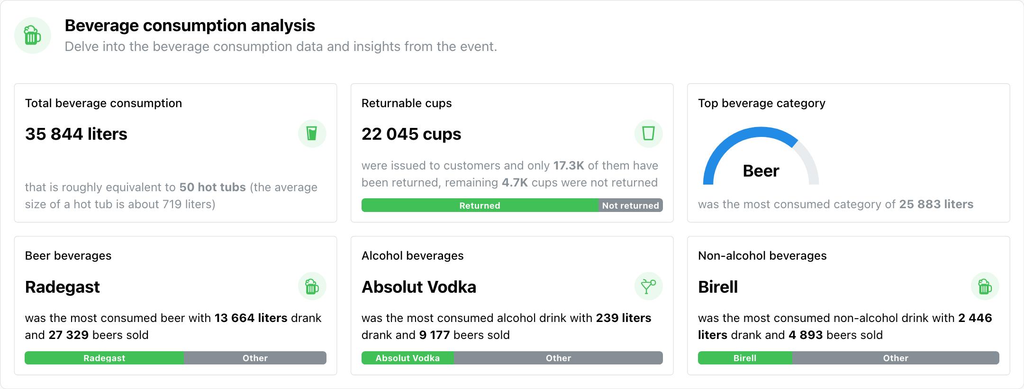
Results
Data Analysis Results
29 Research Questions answered
– Cashflow and Revenue Sources
– Performance Indicators
– Beverage Consumption
– Customers
Dashboard Prototype
Using Python, Dash and Plotly

Slide 25
Results
Data Analysis Results
29 Research Questions answered
– Cashflow and Revenue Sources
– Performance Indicators
– Beverage Consumption
– Customers
Dashboard Prototype
Using Python, Dash and Plotly

Slide 26
Results
Data Analysis Results
29 Research Questions answered
– Cashflow and Revenue Sources
– Performance Indicators
– Beverage Consumption
– Customers
Dashboard Prototype
Using Python, Dash and Plotly

Slide 27
Conclusion
Summary of Achievements
Professional Impact
Lessons Learned

Slide 28
Conclusion
Summary of Achievements
Comprehensive Data Analysis
Processed over 141,000 transactions
Answered all 29 research questions
Presented most results in a clear graphical way
Technical Implementation
Developed functional dashboard prototype
Created efficient data processing pipeline
Implemented a working anonymization solution
Professional Impact
Lessons Learned

Slide 29
Conclusion
Summary of Achievements
Direct Implementation in NFCtron Hub
New timeline analysis component (Dec 2024)
Improved data collection and structure
External Validation
Major festival organizer independently conducted similar analysis
Their approach closely aligned with thesis methodology
Confirms relevance and value of chosen metrics
Professional Impact
Lessons Learned

Slide 30
Conclusion
Summary of Achievements
Technical Insights
Importance of data pre-processing
Value of efficient caching mechanisms
Importance of clear objectives definition
Business Insights
Critical metrics and valuable data for organizers
Financial patterns and cash flows at a festival
New opportunities for system improvements
Professional Impact
Lessons Learned

Slide 31
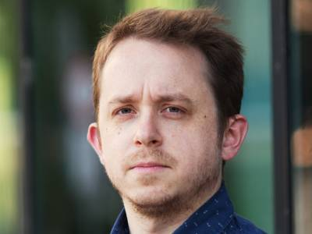
Questions from Reviews
Thesis Supervisor
Mgr. Václav Alt, Ph.D.
1. Could you elaborate on to what extent was the customer (The Organizer) involved in the development? Did they present a set of requirements you ought to fulfill, or was it more of a leap of faith?
2. One of your main concerns before you started working on the project was the anonymization of the data. From the thesis I understand it went quite smoothly. Could you comment on your experience with anonymization? Do you have any suggestions on how to do it differently?
3. Would you wish to alter the data collection somehow? (gather some data that was not gather, choose a different format etc)

Slide 32
Questions from Reviews
Thesis Supervisor
Mgr. Václav Alt, Ph.D.
1. Could you elaborate on to what extent was the customer (The Organizer) involved in the development? Did they present a set of requirements you ought to fulfill, or was it more of a leap of faith?
2. One of your main concerns before you started working on the project was the anonymization of the data. From the thesis I understand it went quite smoothly. Could you comment on your experience with anonymization? Do you have any suggestions on how to do it differently?
3. Would you wish to alter the data collection somehow? (gather some data that was not gather, choose a different format etc)

Slide 33
Questions from Reviews
Thesis Supervisor
Mgr. Václav Alt, Ph.D.
1. Could you elaborate on to what extent was the customer (The Organizer) involved in the development? Did they present a set of requirements you ought to fulfill, or was it more of a leap of faith?
2. One of your main concerns before you started working on the project was the anonymization of the data. From the thesis I understand it went quite smoothly. Could you comment on your experience with anonymization? Do you have any suggestions on how to do it differently?
3. Would you wish to alter the data collection somehow? (gather some data that was not gather, choose a different format etc)

Slide 34
Questions from Reviews
Thesis Supervisor
Mgr. Václav Alt, Ph.D.
1. Could you elaborate on to what extent was the customer (The Organizer) involved in the development? Did they present a set of requirements you ought to fulfill, or was it more of a leap of faith?
2. One of your main concerns before you started working on the project was the anonymization of the data. From the thesis I understand it went quite smoothly. Could you comment on your experience with anonymization? Do you have any suggestions on how to do it differently?
3. Would you wish to alter the data collection somehow? (gather some data that was not gather, choose a different format etc)

Slide 35
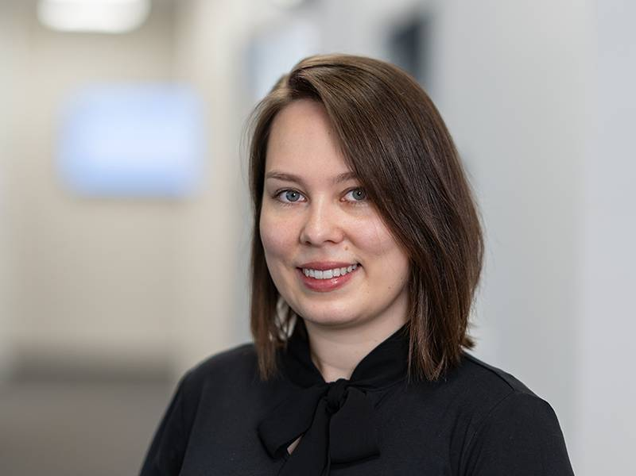
Questions from Reviews
Thesis Opponent
Ing. Hana Flusková
1. Do the KPIs and metrics in the NFCtron app vary by customer or do all customers have the same options in the app?
2. Why is the student only looking at the best performance and metrics, not the worst, where potentially the client is incurring financial losses and should be focused on addressing them?
3. What is the relationship between KPIs and RQ questions?

Slide 36
Questions from Reviews
Thesis Opponent
Ing. Hana Flusková
1. Do the KPIs and metrics in the NFCtron app vary by customer or do all customers have the same options in the app?
2. Why is the student only looking at the best performance and metrics, not the worst, where potentially the client is incurring financial losses and should be focused on addressing them?
3. What is the relationship between KPIs and RQ questions?

Slide 37
Questions from Reviews
Thesis Opponent
Ing. Hana Flusková
1. Do the KPIs and metrics in the NFCtron app vary by customer or do all customers have the same options in the app?
2. Why is the student only looking at the best performance and metrics, not the worst, where potentially the client is incurring financial losses and should be focused on addressing them?
3. What is the relationship between KPIs and RQ questions?

Slide 38
Questions from Reviews
Thesis Opponent
Ing. Hana Flusková
1. Do the KPIs and metrics in the NFCtron app vary by customer or do all customers have the same options in the app?
2. Why is the student only looking at the best performance and metrics, not the worst, where potentially the client is incurring financial losses and should be focused on addressing them?
3. What is the relationship between KPIs and RQ questions?

